Slide 1
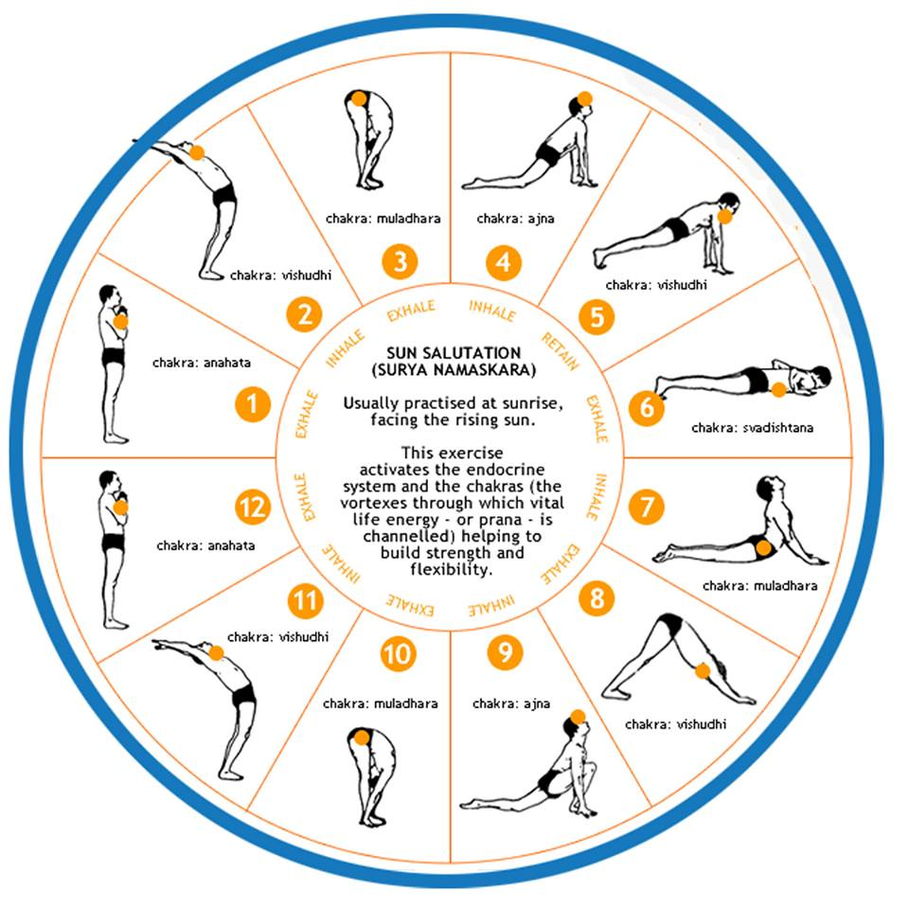
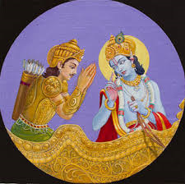
Y
GITA
YOGITA
Hindu Swayamsevak Sangh, USA
www.balagokulam.org\yogita

Slide 2
What/Why YOGITA?
Y
GITA
Contest for Children on Yoga and Gita
Celebrate125th Year of Swami Vivekanandas address at the World Parliament of Religion, Chicago
Hindu Swayamsevak Sangh, USA
www.balagokulam.org\yogita

Slide 3
Basics…
Y
GITA
Ages: Kids age 12 and below
Levels: Local (Shaka), City (Vibhag)
When: September / October 2018
Hindu Swayamsevak Sangh, USA
www.balagokulam.org\yogita

Slide 4
Different Levels
Level 1 – September / Local centers
All Registered Children
Oral / Physical
Level 2 – October / City
All winners of Level 1
Oral / written / Physical
Prize Distribution – Vijayadasami Utsav
Y
GITA
Hindu Swayamsevak Sangh, USA
www.balagokulam.org\yogita

Slide 5
Prizes!!!
Y
GITA
Certificate of Participation
Prizes for Winners
Hindu Swayamsevak Sangh, USA
www.balagokulam.org\yogita

Slide 6
What do we need to do now?
Sampark
Temples
Religious and Linguistic Organizations
Music and Dance Schools
Bhajan Groups
Our Neighbors
Colleagues / friends
Y
GITA
Hindu Swayamsevak Sangh, USA
www.balagokulam.org\yogita

